Slide 1

Learning Traffic Deeply as Images with Partially Observed Data
Travel Time Prediction on I-80 E from Davis to West Sacramento
Jin Guo
06/04/2019

Slide 2
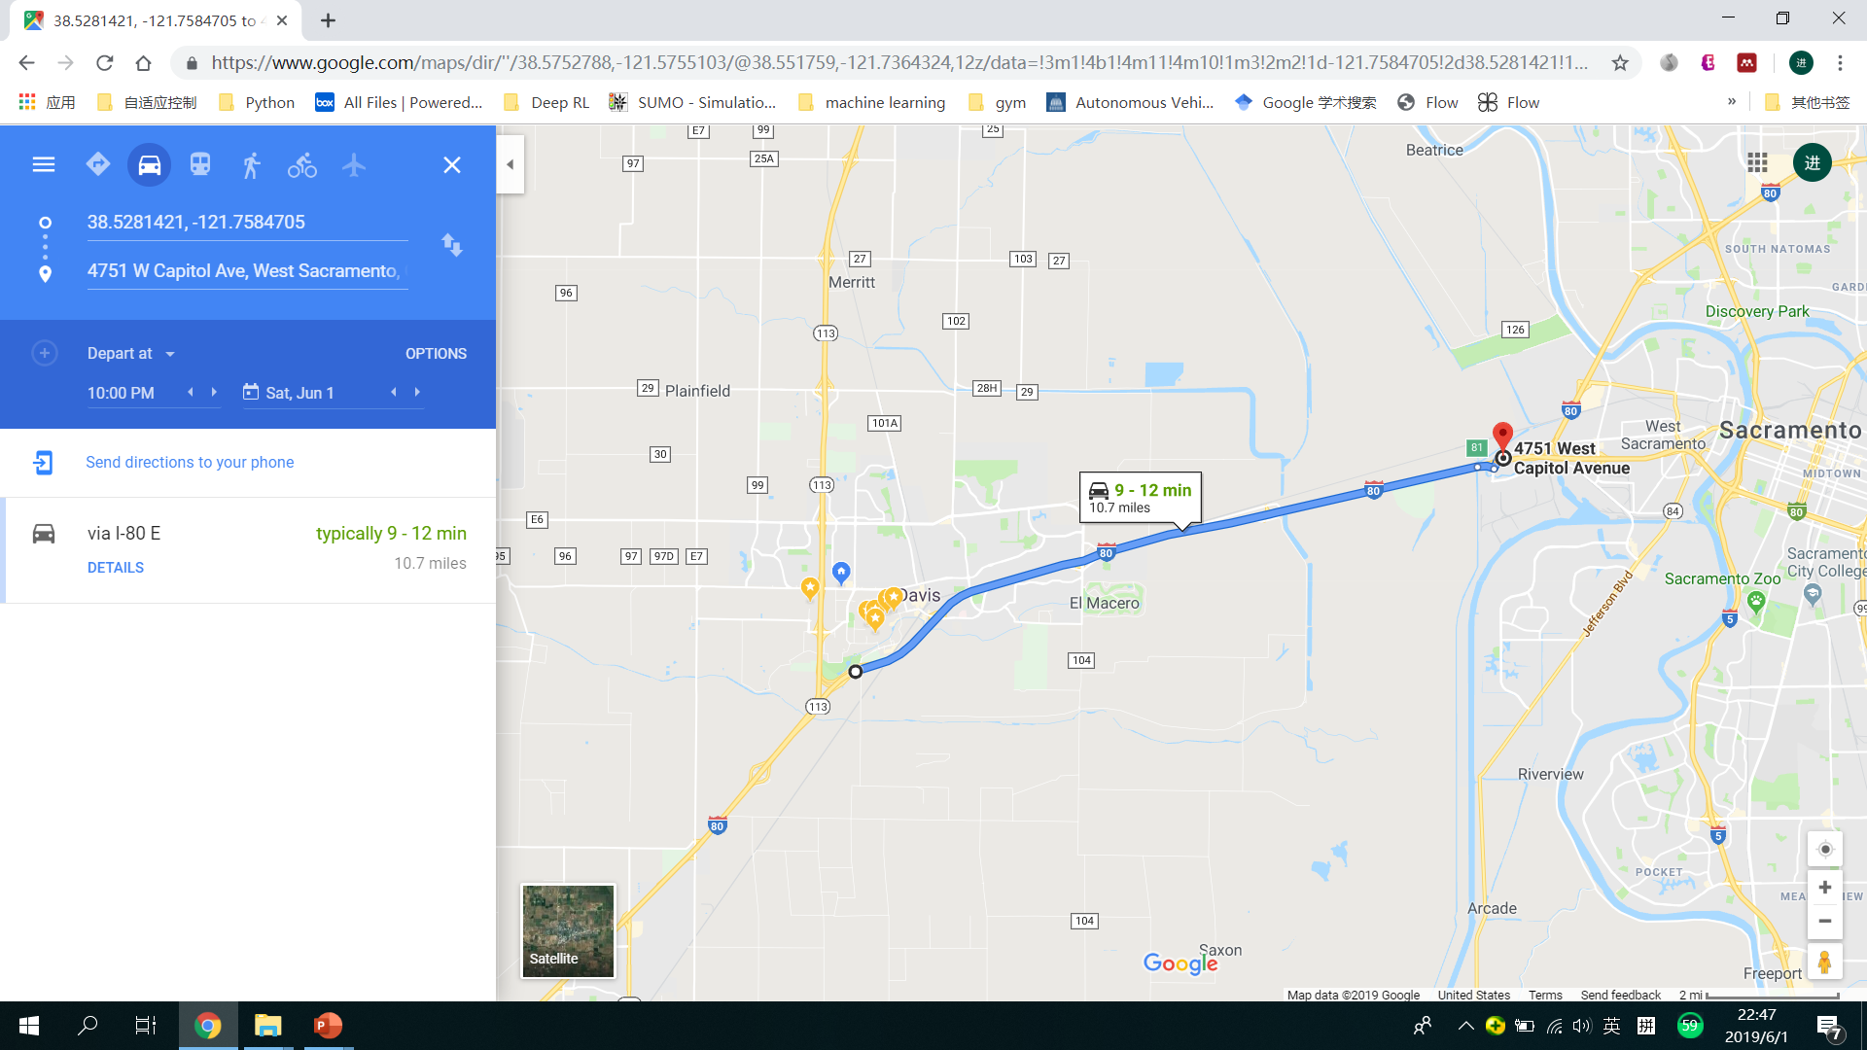

Travel Time
May 31, Friday, 7:00 AM
May 31, Friday, 4:00 PM
How is the color shown in Google Map related to our travel time?

Slide 3
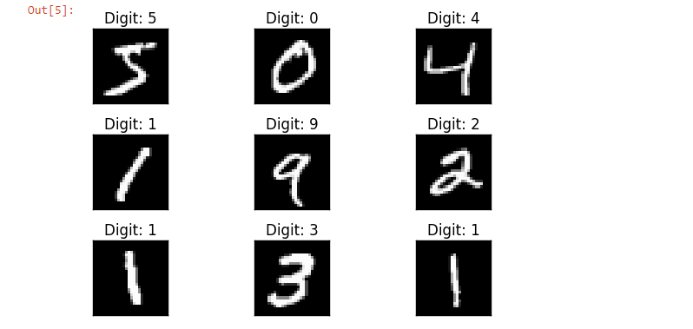
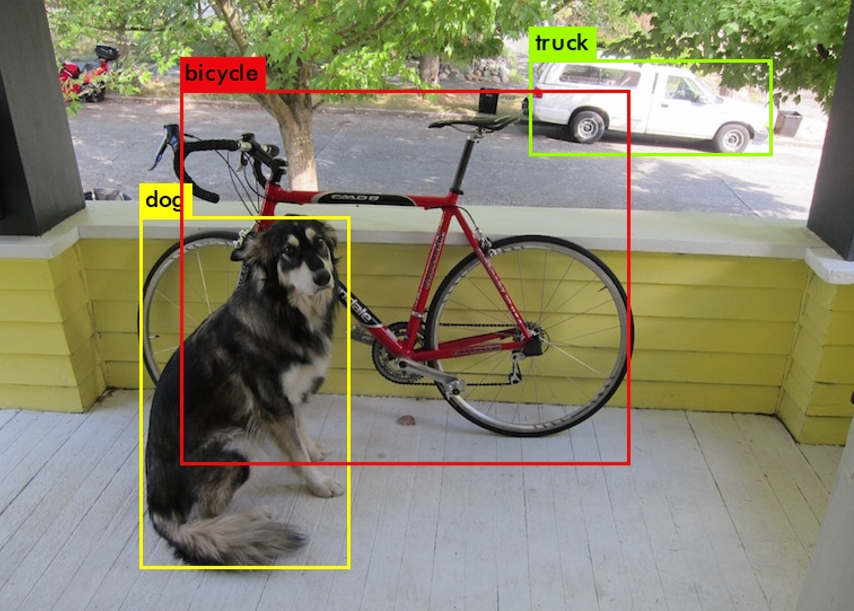
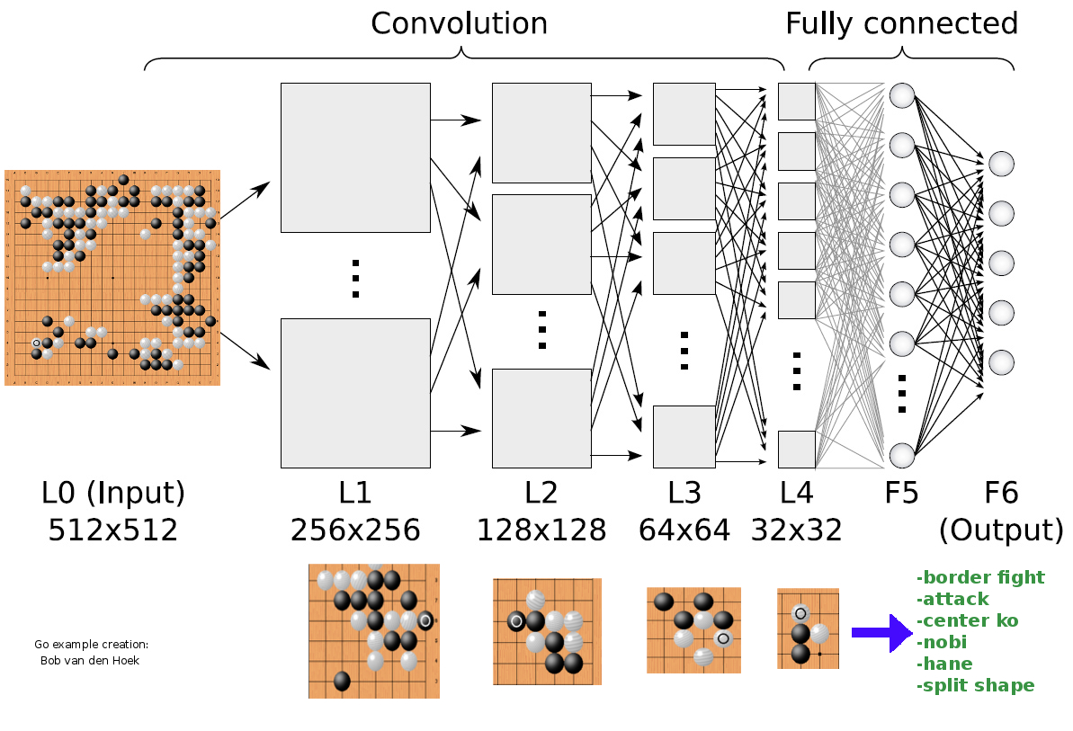
What Computer Vision Can Do Now?
Recognition of Hand Written Digits
Classification of Objects
Master of Go Games
Source: MNIST Data Set
Source: YOLO v3
Source: http://deeplearningskysthelimit.blogspot.com/2016/04/part-2-alphago-under-magnifying-glass.html
Is there another magic box that can tell us how many time we will spend on the road?

Slide 4



Three Steps to Build the Black Box
Collect and Preprocess Data
Convert Traffic Information to Images
Design and Train the Prediction Model

Slide 5
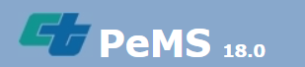
Data Collection
Caltrans Performance Measurement System (PeMS)
Vehicle Detector Station (VDS)
15 VDSs in the selected freeway segment

Slide 6
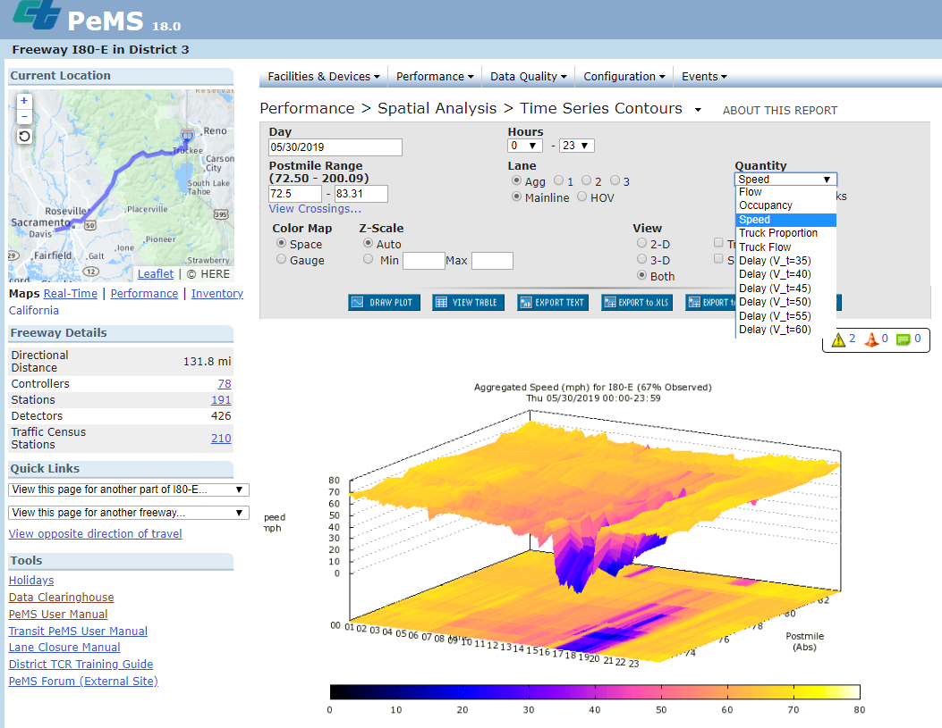
Data Collection
Time | AggOccupancy | AggFlow | AggSpeed | % Observed
00:00 | 0.01 | 40 | 67.40 | 100.00
00:05 | 0.01 | 19 | 67.40 | 100.00
00:10 | 0.02 | 43 | 67.30 | 100.00
00:15 | 0.01 | 68 | 68.00 | 0.00
00:20 | 0.01 | 89 | 67.40 | 100.00
00:25 | 0.01 | 67 | 67.40 | 100.00
00:30 | 0.04 | 68 | 67.40 | 100.00
00:35 | 0.02 | 76 | 67.40 | 100.00
00:40 | 0.02 | 67 | 67.40 | 0.00
00:45 | 0.03 | 97 | 67.40 | 100.00
00:50 | 0.02 | 59 | 67.40 | 100.00
00:55 | 0.04 | 57 | 67.40 | 100.00
01:00 | 0.02 | 0 | 67.40 | 33.33
01:05 | 0.02 | 68 | 67.40 | 100.00
Time
Occupancy
Flow
Speed
Observation rate
X 15 VDSs
X 17 + 1 + 1 Days
Training
Set
Test Set 1
Test Set 2
Same Detector Health
Different Detector Health

Slide 7
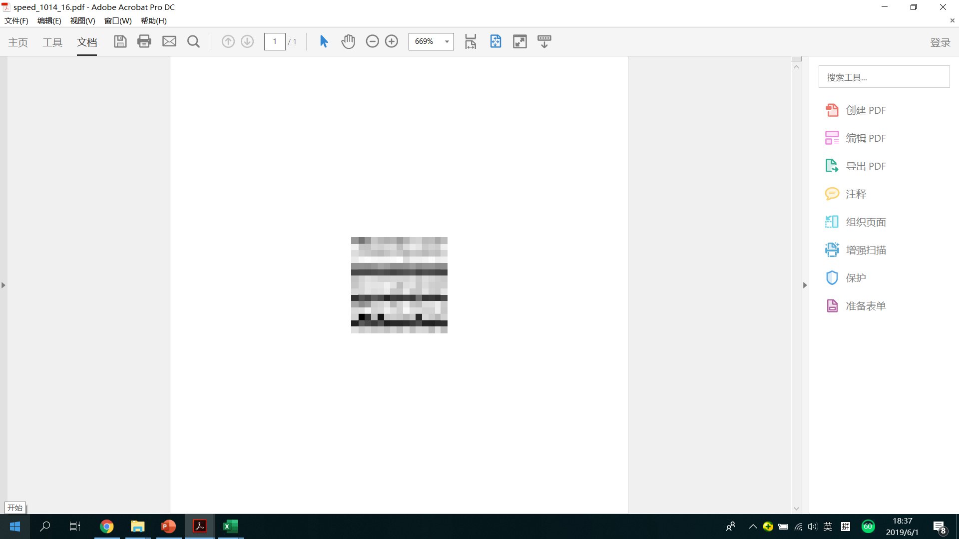



Convert Traffic Information to Images
VDS15
….
pandas.read_excel( )
scipy.misc.imsave( )
VDS2
VDS1
t
t+5min …… t+5min*14

Slide 8
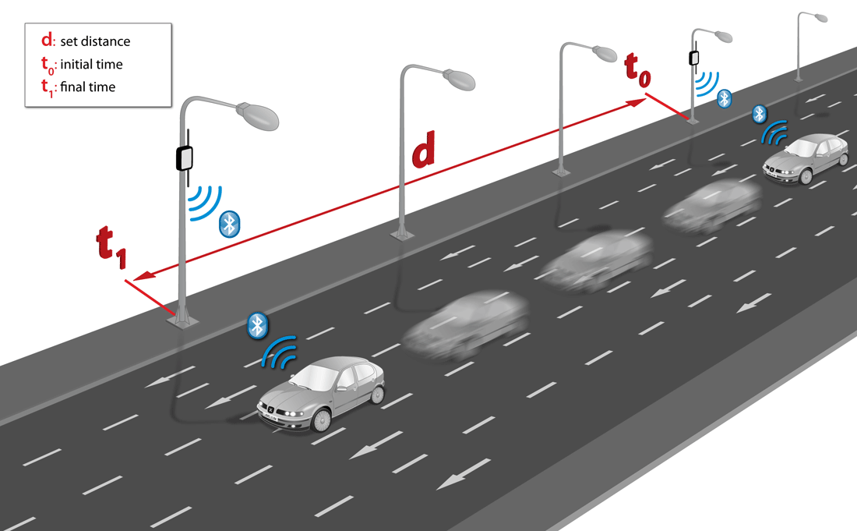

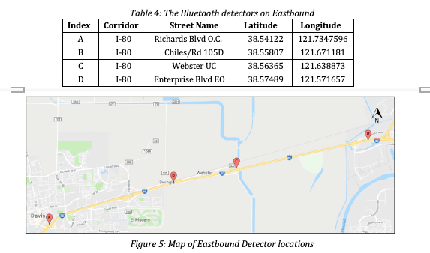
Travel Time Mesurement
V2I Technology
Source: https://icyapril.com/privacy/2016/11/21/tracking-drivers-through-their-phones.html
time | traveltime | segment | date
0.001991 | 185 | 80_Richards80_Chiles | 10/14/2018
0.002535 | 198 | 80_Richards80_Chiles | 10/14/2018
0.005081 | 181 | 80_Richards80_Chiles | 10/14/2018
0.005833 | 177 | 80_Richards80_Chiles | 10/14/2018
0.006701 | 206 | 80_Richards80_Chiles | 10/14/2018
0.007778 | 192 | 80_Richards80_Chiles | 10/14/2018
0.008368 | 222 | 80_Richards80_Chiles | 10/14/2018
0.009641 | 189 | 80_Richards80_Chiles | 10/14/2018

Slide 9
Travel Time Normalization
time | traveltime | segment | date
0.001991 | 185 | 80_Richards80_Chiles | 10/14/2018
0.002535 | 198 | 80_Richards80_Chiles | 10/14/2018
0.005081 | 181 | 80_Richards80_Chiles | 10/14/2018
0.005833 | 177 | 80_Richards80_Chiles | 10/14/2018
0.006701 | 206 | 80_Richards80_Chiles | 10/14/2018
0.007778 | 192 | 80_Richards80_Chiles | 10/14/2018
0.008368 | 222 | 80_Richards80_Chiles | 10/14/2018
0.009641 | 189 | 80_Richards80_Chiles | 10/14/2018
Every 5 minutes
Calculate mean μ and standard deviation σ
Aggregated Travel Time =
mean(i) for i >= μ - σ and i <= μ + σ

Slide 10
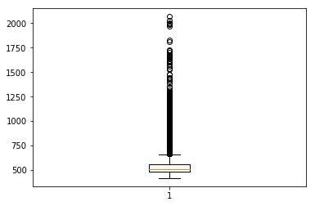
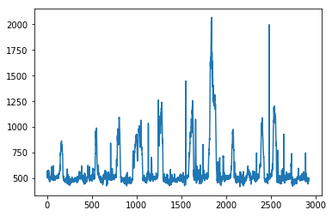
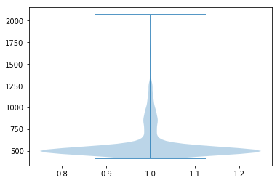
Travel Time Normalization
Box Plot of Travel Time
Time Series of Travel Time
Violin Plot of Travel Time

Slide 11
Travel Time Normalization
<450s
480s
510s
540s
570s
600s
630s
660s
690s
720s
>750s
0
1
2
3
4
5
6
7
8
9
Mph:
>80.0
75.0
70.6
66.7
63.2
60.0
57.1
54.6
52.2
50.0
<48.0
Regression → Classification

